Slide 1
Excel Data Validation
&
Conditional Formatting
By NIVED SUDHINDRAN

Slide 2
Data Validation
Where you can find this option-
Data Tab → Data Validation
Use – To restrict users to use specific data type in a particular cell or column(s)
Data Types – Whole Numbers/ Decimals/ Date /Time /Text length/ Choose from a list, etc

Slide 3
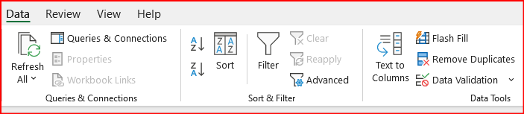
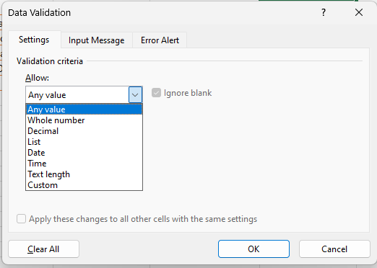
Data Validation

Slide 4
Conditional Formatting
Where you can find this option-
Home Tab → Conditional Formatting
Use – To format a cell dynamically based on the value entered in it
Types – Highlight cells, Top/Bottom rules, Data Bars, etc

Slide 5
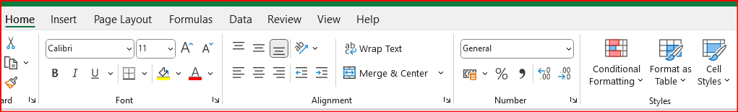
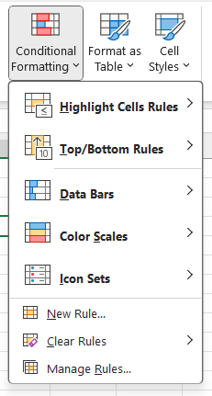
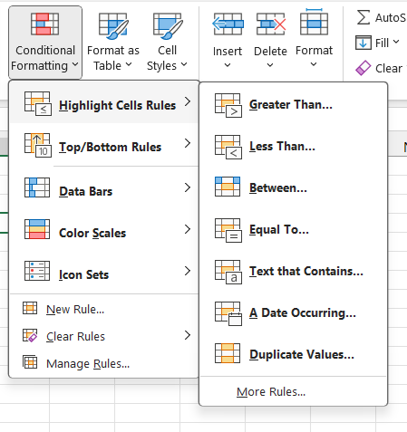
Conditional Formatting

